Slide 1
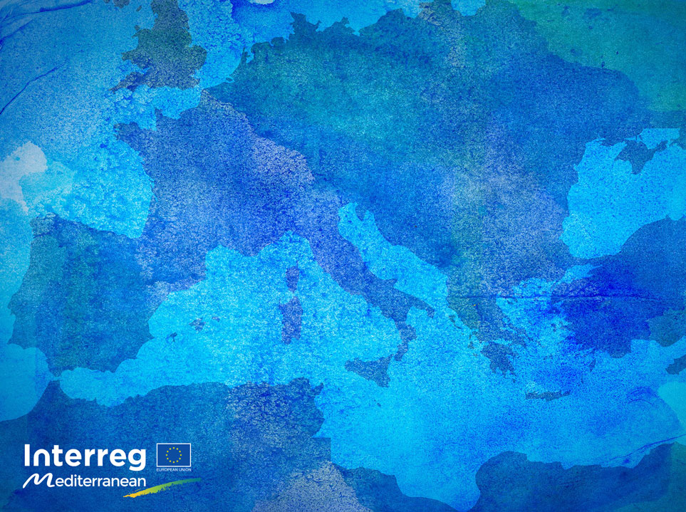



SHAREMED International Workshpp
MALTA | 13/14th September 2022
Connecting marine research and boosting benefits to Society
Approaches to monitor Ostreopsis blooms to prevent impacts on human health
Elisa Berdalet, ICM-CSIC, Barcelona

Slide 2

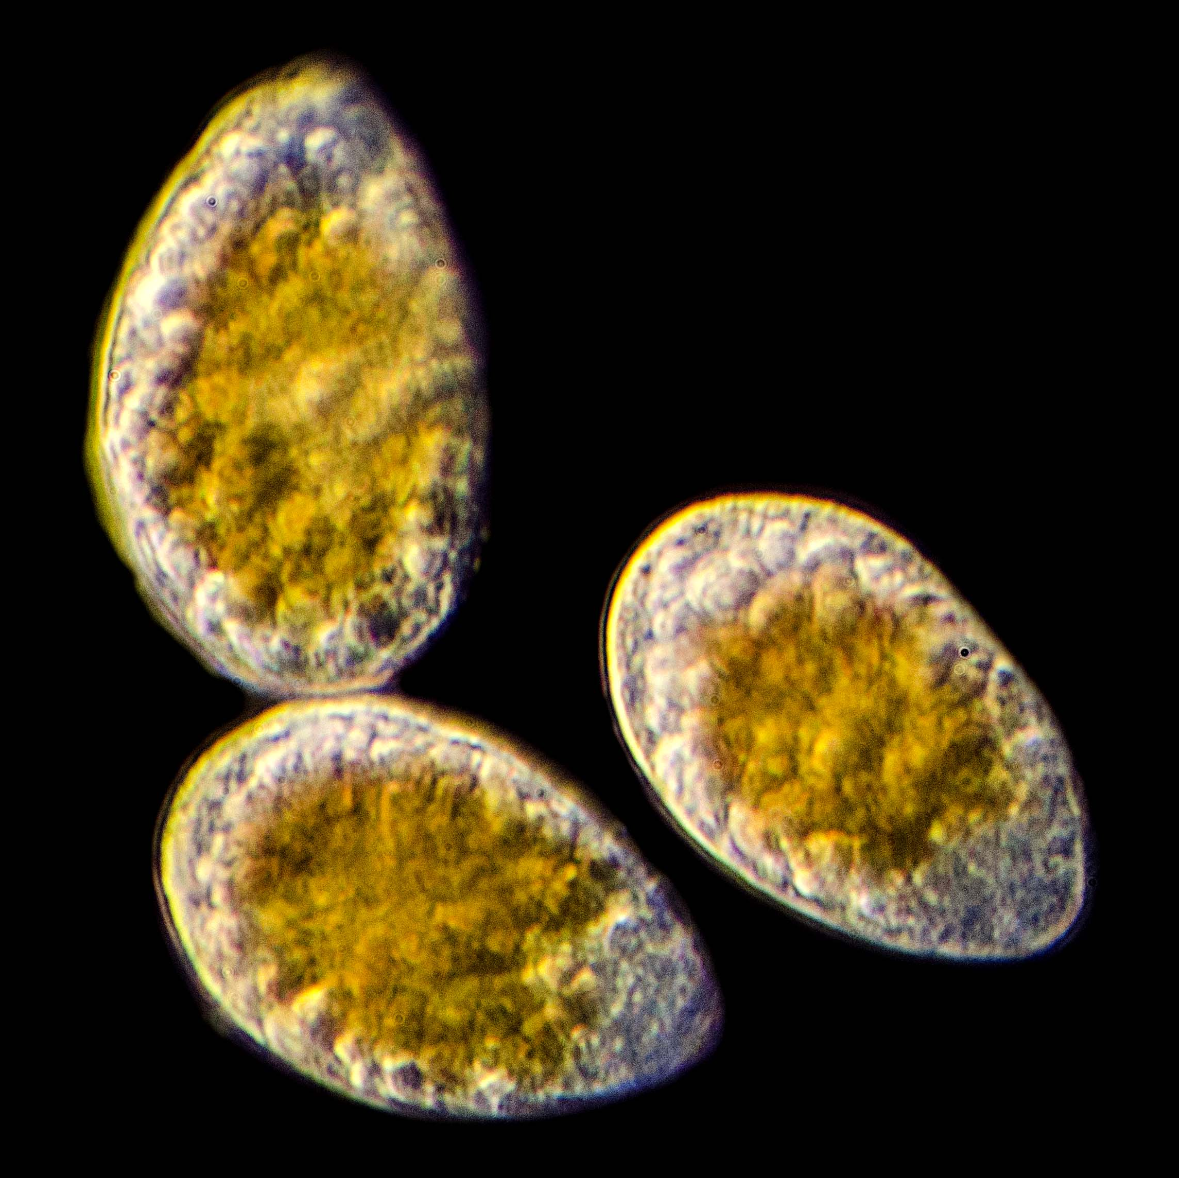
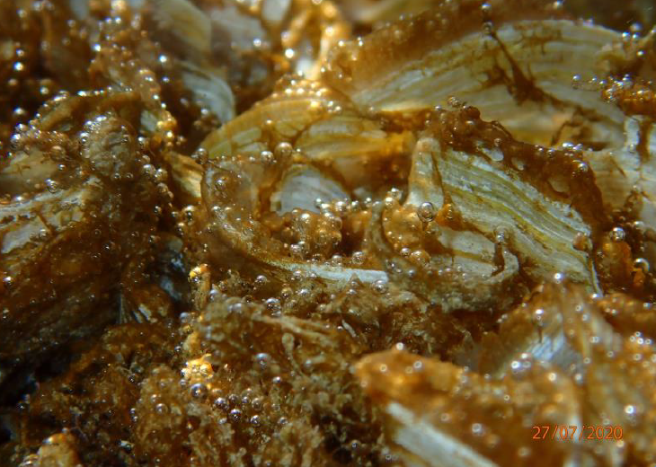
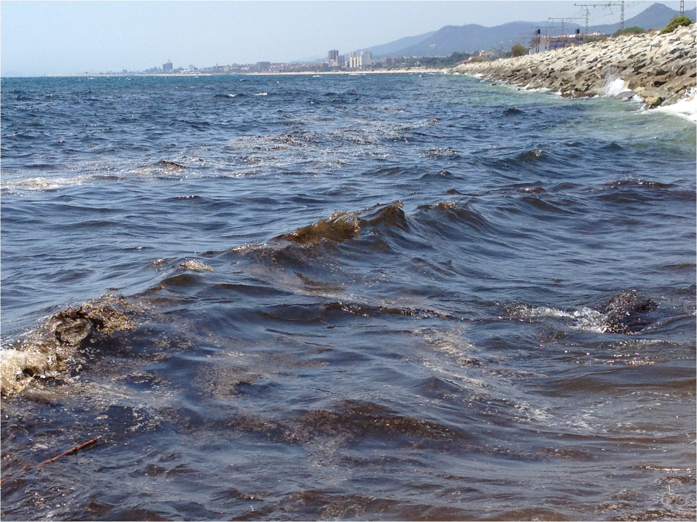
Approaches to monitor Ostreopsis blooms
to prevent impacts on human health
1. General concepts about Ostreopsis and its blooms
2. Biogeographic distribution of Ostreopsis
3. International coordination concerning Ostreopsis blooms
4. Monitoring Ostreopsis blooms. Shared protocol and data

Slide 3
1. General concepts about Ostreopsis and its blooms
Some harmful blooms causing respiratory and cutaneous disorders
@RubénDuro
Tychoplanktonic
Attached to biotic and abiotic benthic subtstrates
Scheme source: Mangialajo et al. 2017. http://dx.doi.org/10.1016/j.hal.2017.03.002

Slide 4
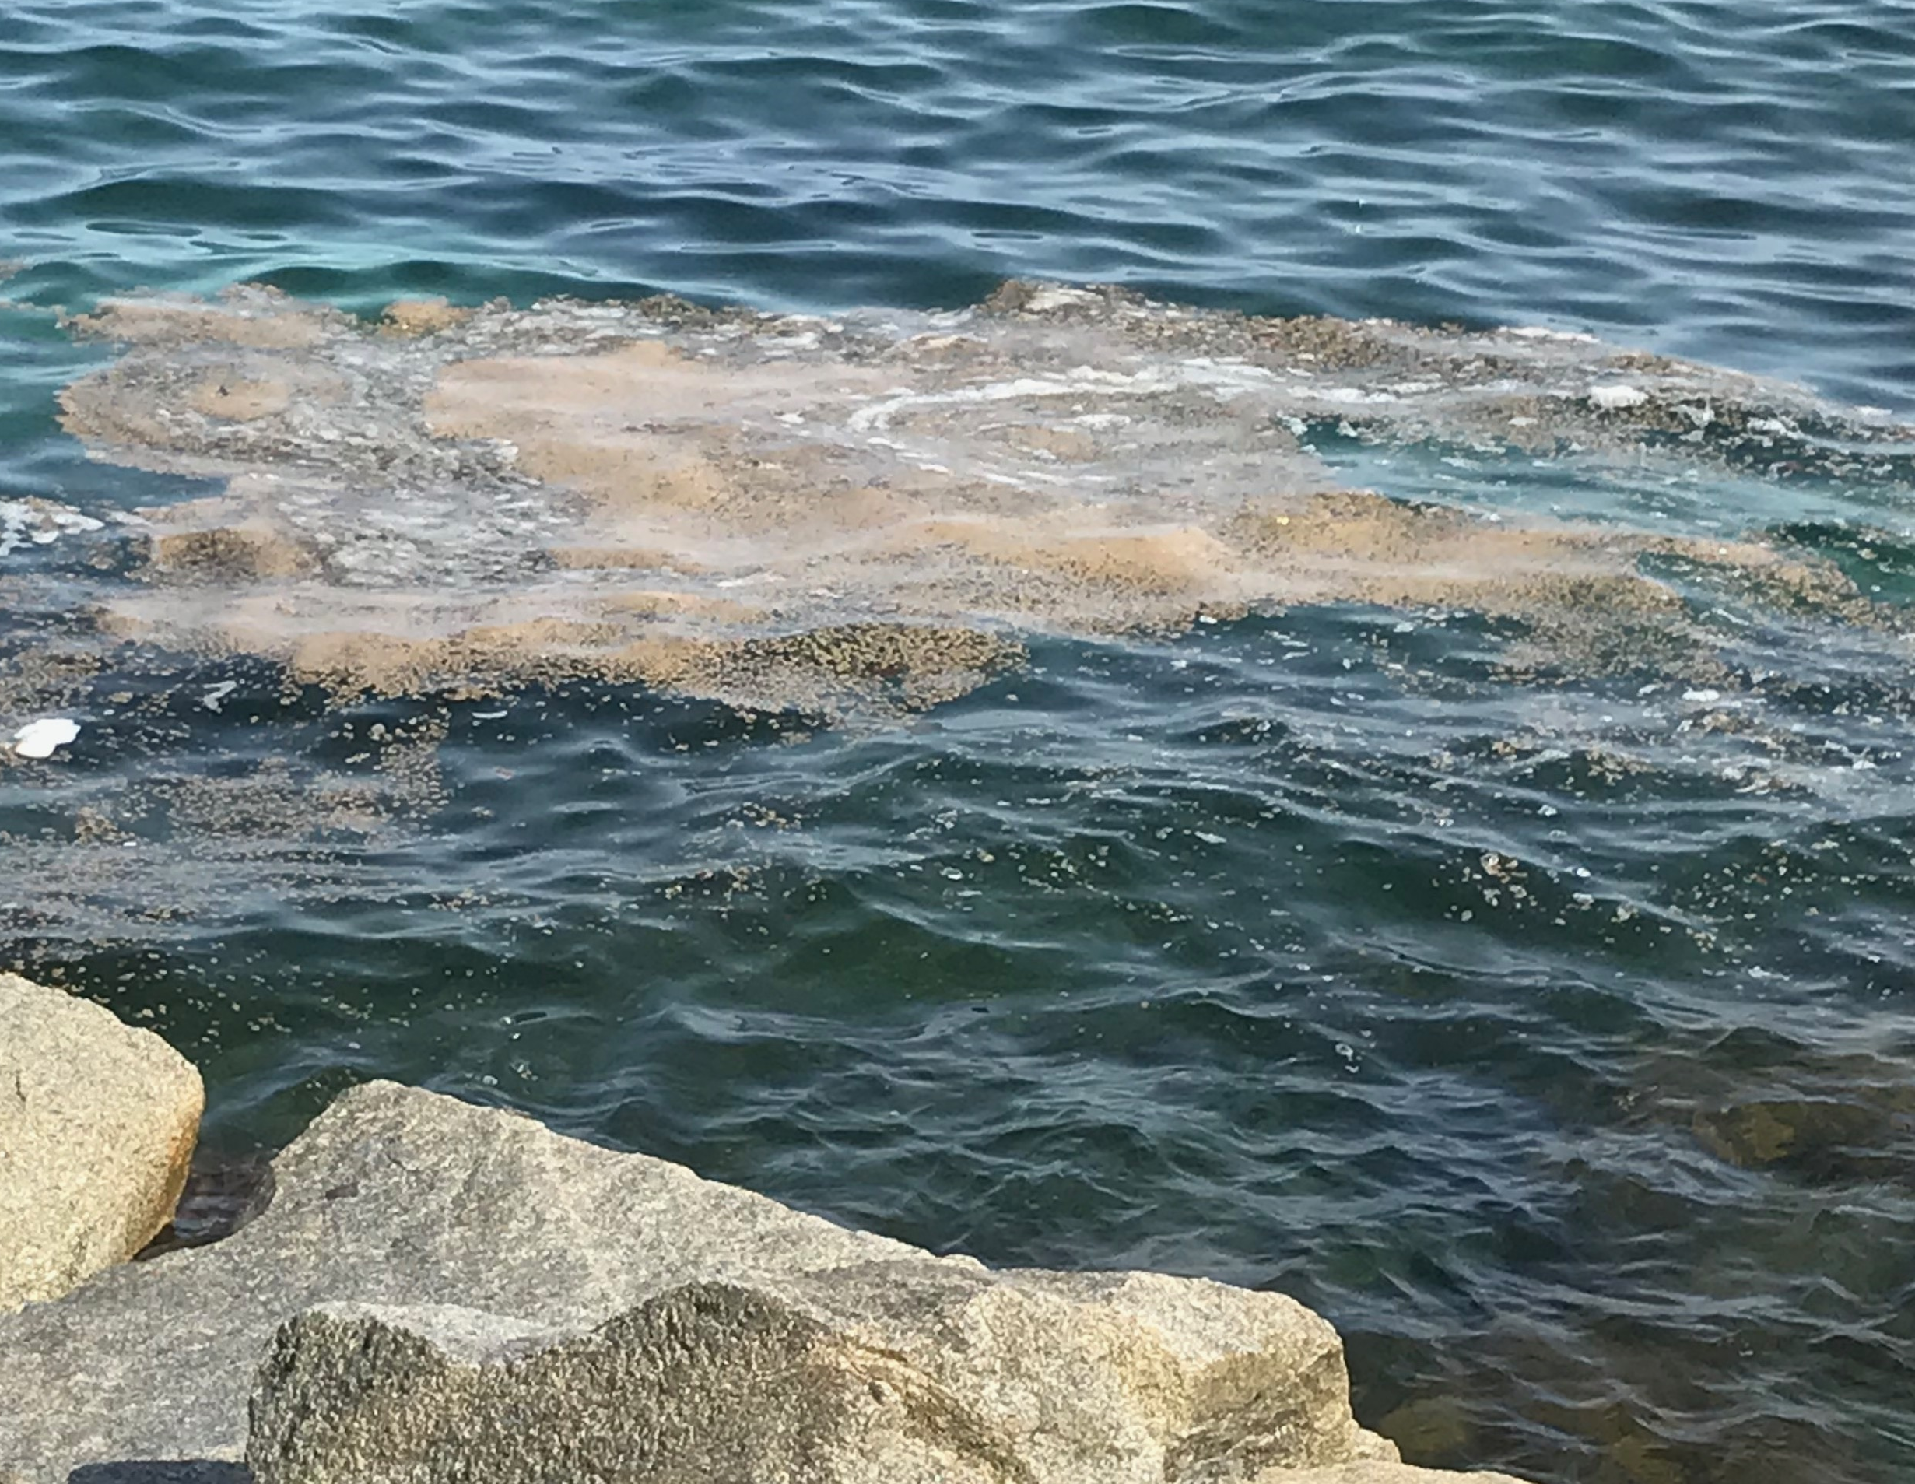
1. Generalities. Aerosol inhalation related symptoms in humans
Throat irritation
Nasal congestion
Eye irritation
Cough
Wheezing
Shortness of Breath
Chest tightness
Headache
Itchy skin??
Diarrhoea??
Upper Airway
Symptoms gone after 24-72h out of the beach
No specific treatment (ibuprofen o paracetamol)
No contagious – "no Covid-like"
Lower Airway
Direct water contact related symptoms

Slide 5
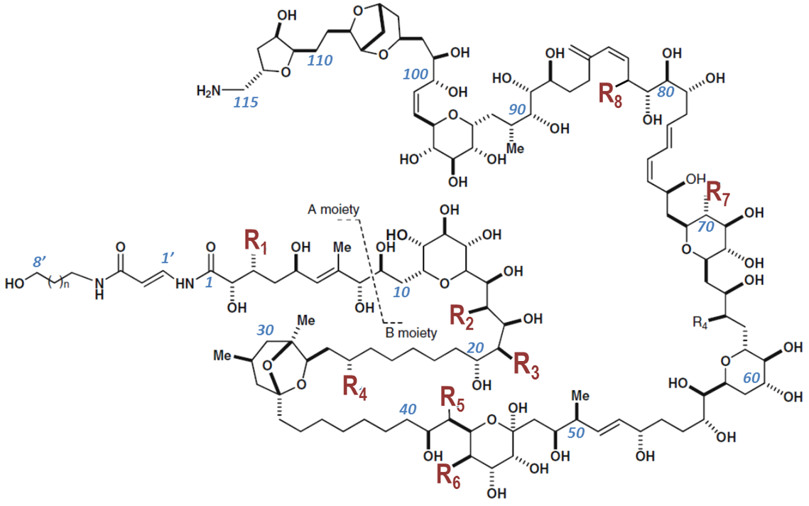
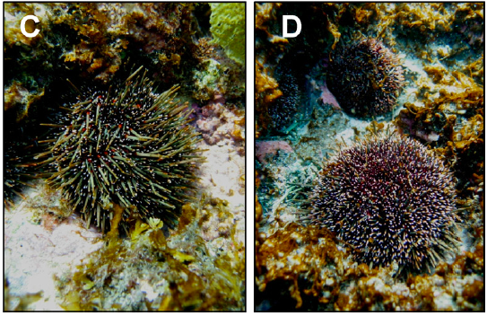
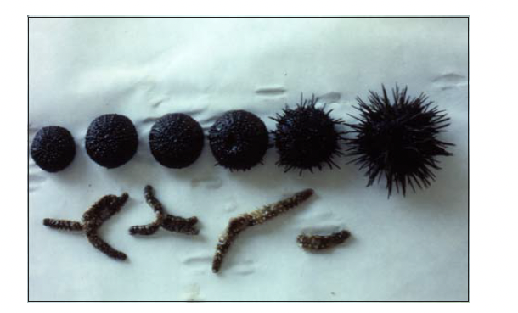
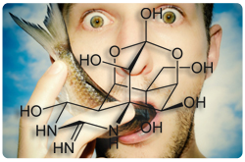


1. Generalities. Toxins produced by different Ostreopsis species
Palytoxin analogues:
Ovatoxins a – k
Ostreocins
Mascarenetoxins
Isobaric palytoxins
Pavaux et al. 2020 (review, Front. Mar. Sci. 7:498).
New toxins: Liguriatoxins, Rivieratoxins
Ternon et al. 2022
https://doi.org/10.3390/toxins14040234
Impacts on human health
(Tubaro et al. 2011, Toxicon 57, 478–495)
not completely proven yet
Impacts on fauna
(review by Pavaux et al 2020; Front. Mar. Sci. 7:498)
mucus has a role in toxicity (Giussani et al. 2015, HA 44, 46-53
In the tropics:
seafood poisoning - palytoxicosis
In temperate latitudes:
cutaneous and respiratory irritations
Shears & Ross 2009, HA 8, 916–925
Shears & Ross 2009,
Biol Ambiente 17, 17-32

Slide 6
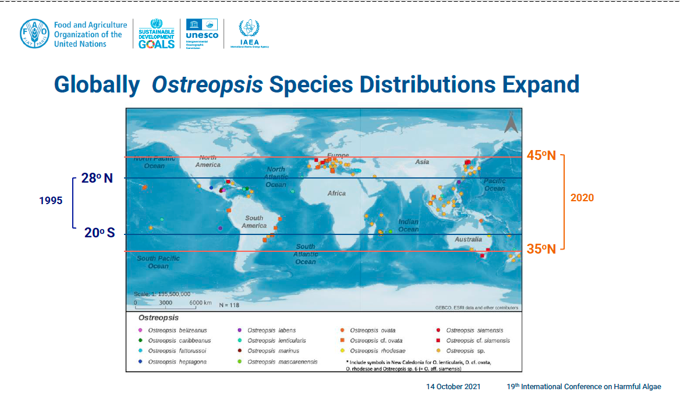
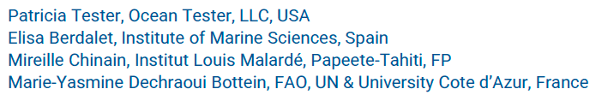
2. Biogeographic distribution of Ostreopsis
Over the past 25 years, the presence of Ostreopsis microalgae has expanded from tropical to temperate areas

Slide 7
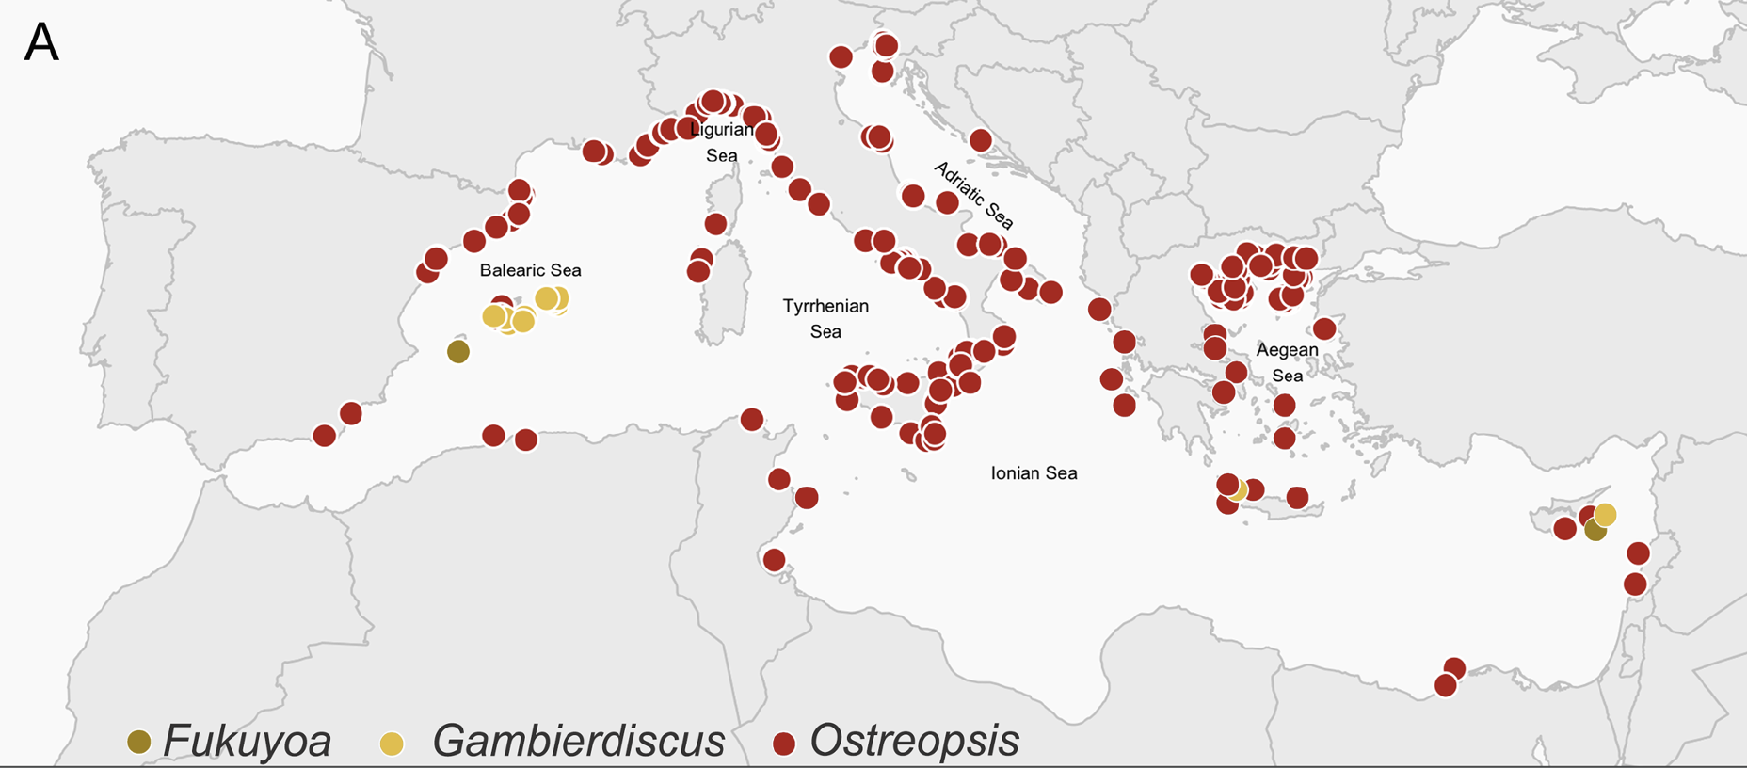
2. Biogeographic distribution of Ostreopsis
In conclusion, main HAB risks derive from high biomass blooms, that reduce water quality, impacts on tourism (main economic activity in the area)
New records of potential risk of ciguatera
Regular blooms at some beaches
HABs in the Mediterranean. Zingone el al. 2021. Harmful Algae 102

Slide 8
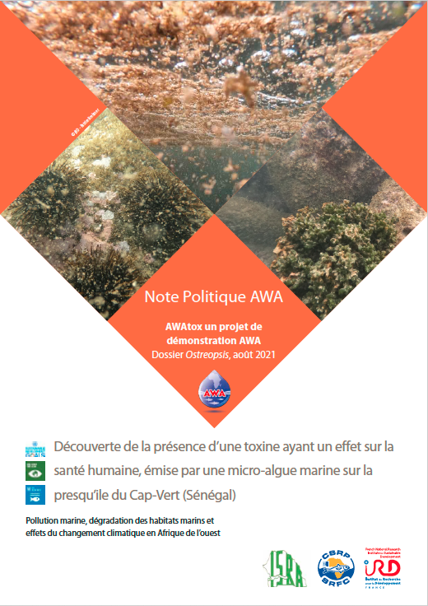
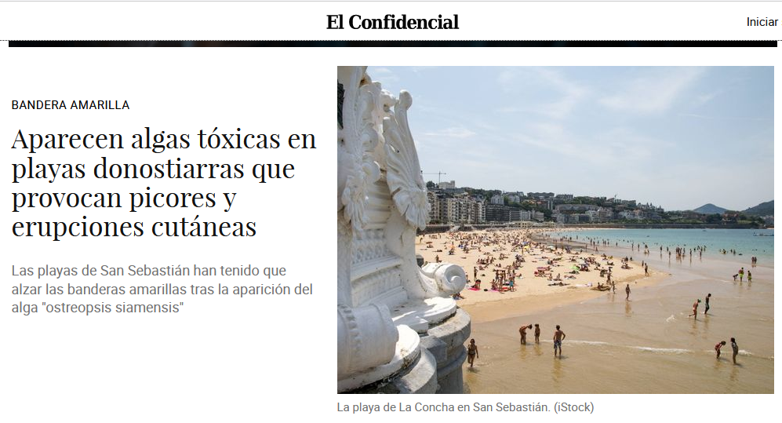
2. Biogeographic distribution of Ostreopsis
August-September 2021:
- Senegal
- Basque country (Biarritz, Donosti) - >700 affected people

Slide 9
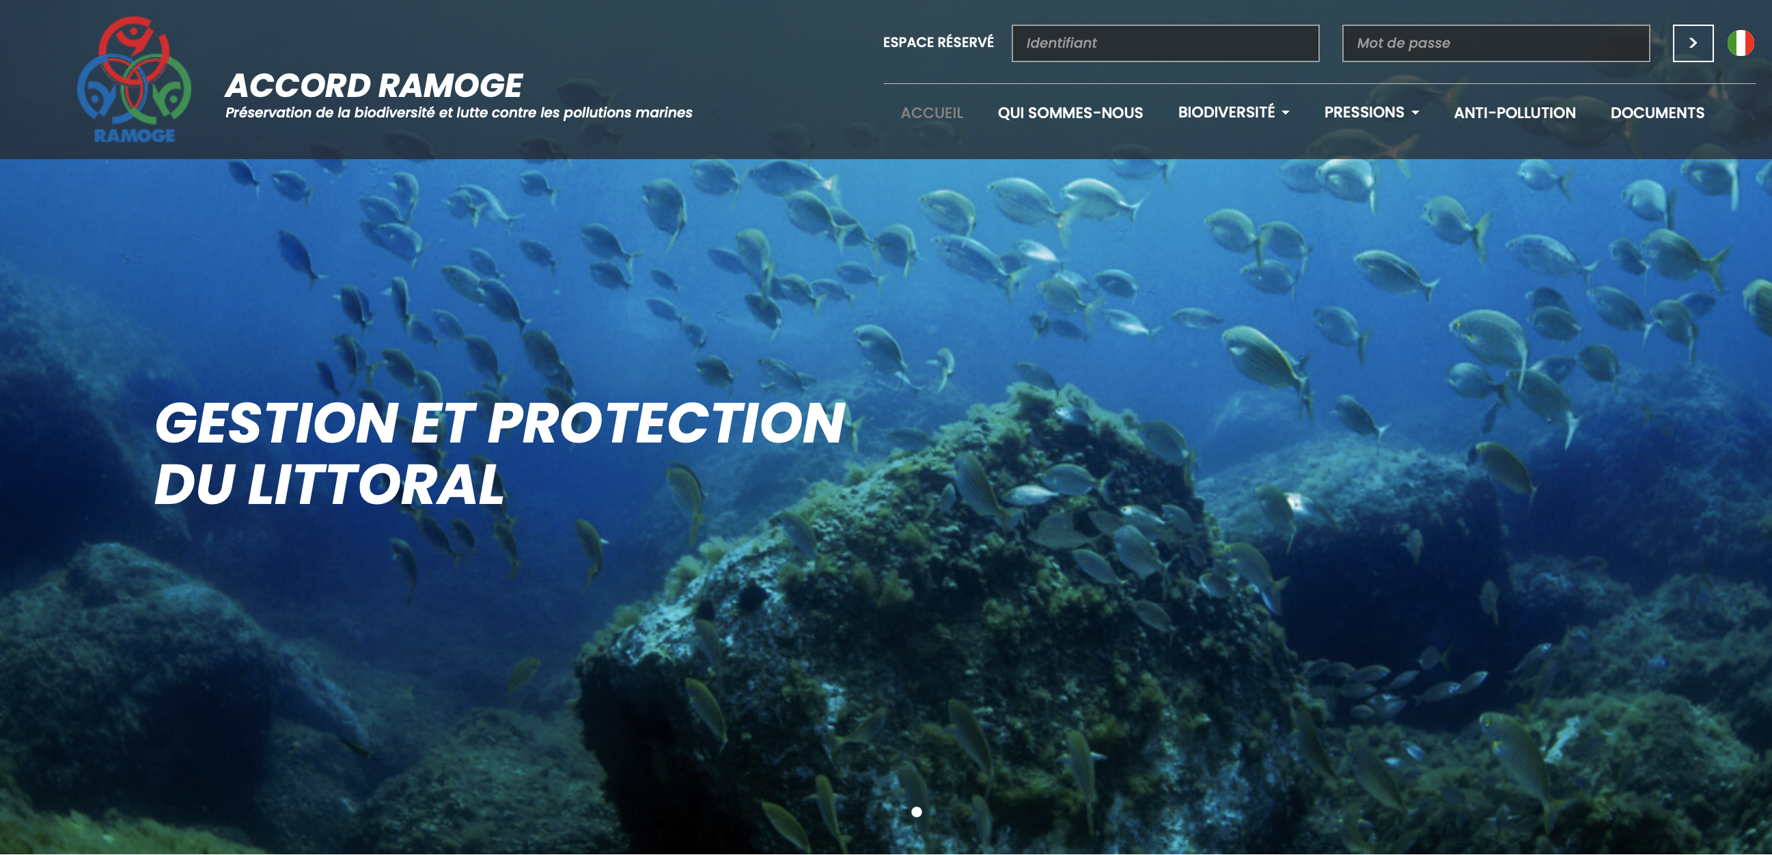
3. International coordination concerning Ostreopsis blooms
RAMOGE ACCORD (www.ramoge.org)
Notes:
Data has been provided by the program of “Monitoring and management of Ostreopsis blooms in the coastal bathing waters of Catalonia” which carried out in collaboration between the Catalan Water Agency and Elisa Berdalet's group which is a member of the Sharemed partner from CSIC.
- Si fos possible, posar Ostreopsis (només capital letter, italics) en el quadre

Slide 10
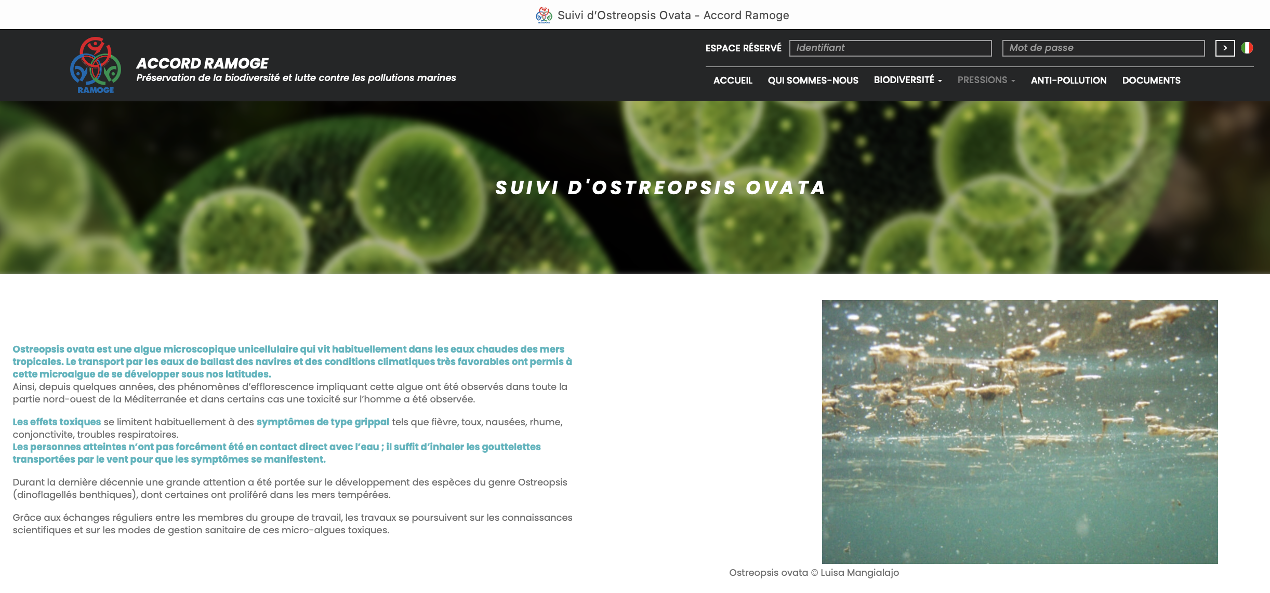
3. International coordination concerning Ostreopsis blooms
RAMOGE ACCORD (www.ramoge.org)
Notes:
Data has been provided by the program of “Monitoring and management of Ostreopsis blooms in the coastal bathing waters of Catalonia” which carried out in collaboration between the Catalan Water Agency and Elisa Berdalet's group which is a member of the Sharemed partner from CSIC.
- Si fos possible, posar Ostreopsis (només capital letter, italics) en el quadre

Slide 11
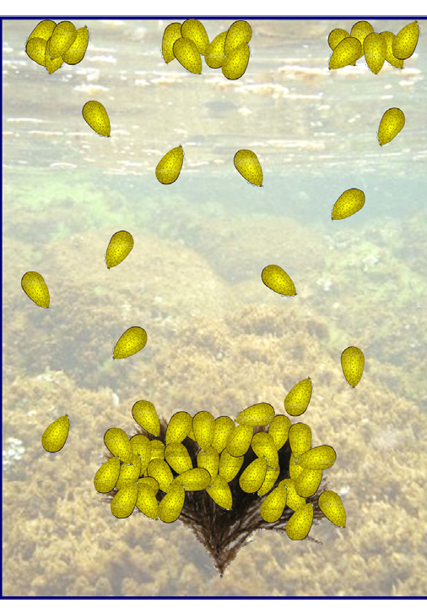
4. Monitoring Ostreopsis blooms. Shared protocol and data
Ostreopsis in the plankton and floating aggregates:
- more directly related to aerosolized toxins
- samples in routine monitoring programmes
Ostreopsis in the benthos:
- bloom reservoir
- samples not included in the monitoring control
- need to establish a standardised and reliable sampling procedure
Mangialajo et al. 2017
Tychoplanktonic:
benthos + plankton + floating at surface

Slide 12
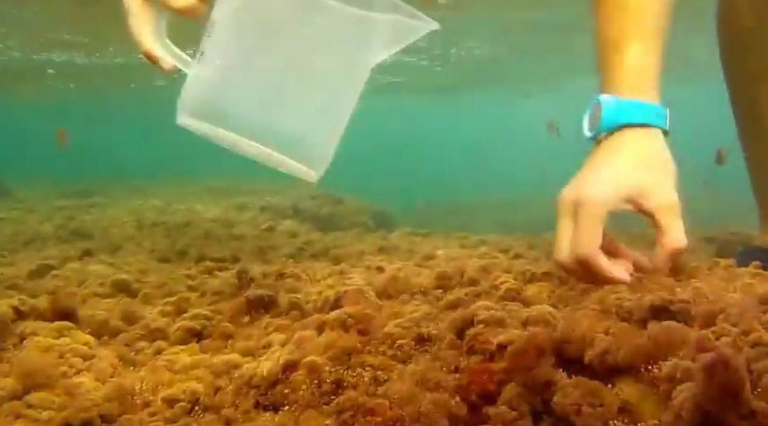


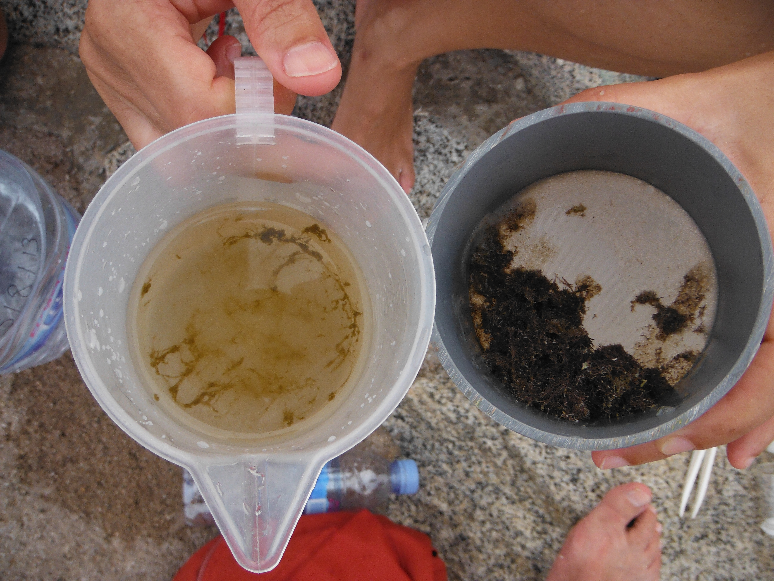
4. Monitoring Ostreopsis blooms. Shared protocol and data
MACROALGAL
FRESH WEIGHT
Macroalgae
+ Seawater
Shake (1 min)
200 µm mesh
Collect 10–20 g of macroalgae
Transfer into plastic beakers with seawater.
Shake (1 min) to release Ostreopsis cells from macroalgae.
Filter through a 200 µm mesh
Measure the volume of percolated seawater
Ostreopsis cells gFW⁻¹
LUGOL's fixation - CELL COUNTS
Microscope
Biochemisty, molecular analysis
Support: OstreoRisk, CoCliME projects

Slide 13
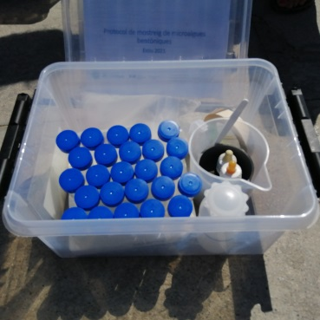
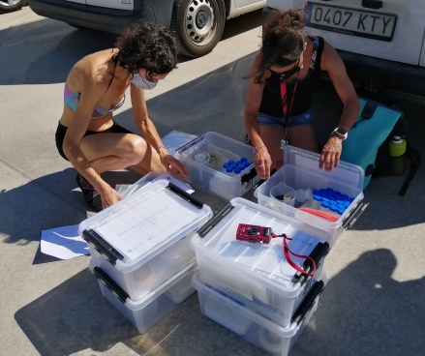
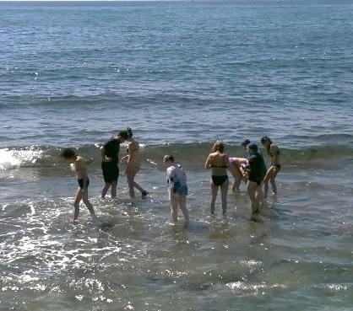
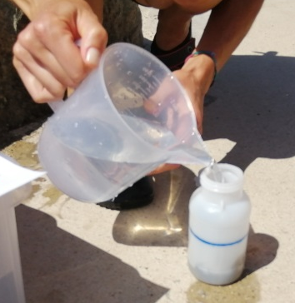
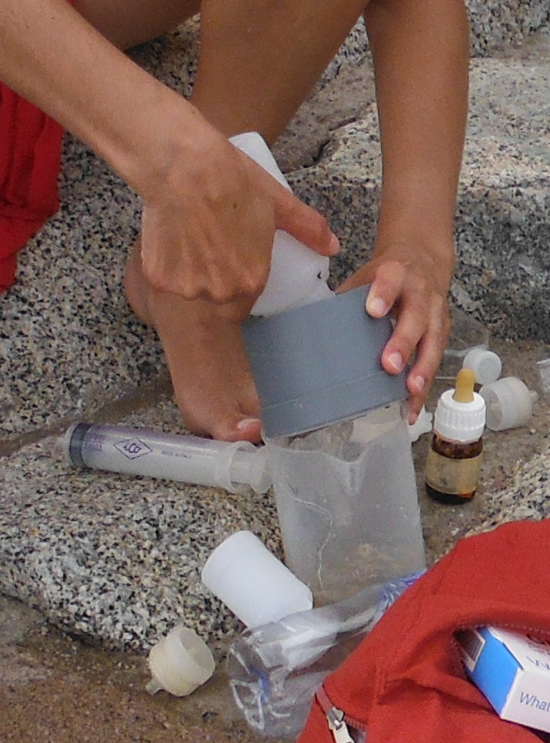
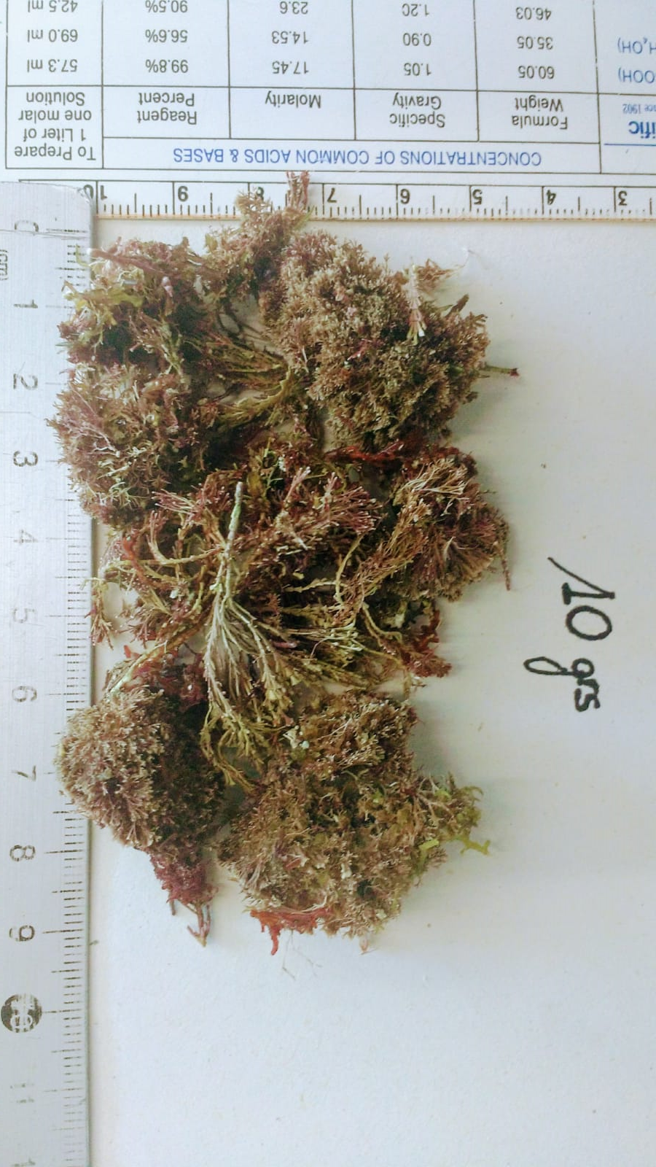
4. Monitoring Ostreopsis blooms. Shared protocol and data
Ostreopsis sampling protocol
(and other species) epiphytes of macroalgae – Collaboration between the ICM and the Catalan Water Agency
1) Training session (sampling)
2) Explanatory leaflet
3) Guide to identifying macroalgae
4) Data shared in the "cloud"
- sampling data
- observations
- photos
- calculations and results

Slide 14
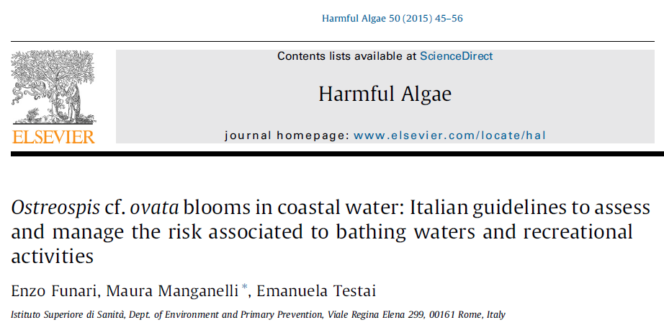
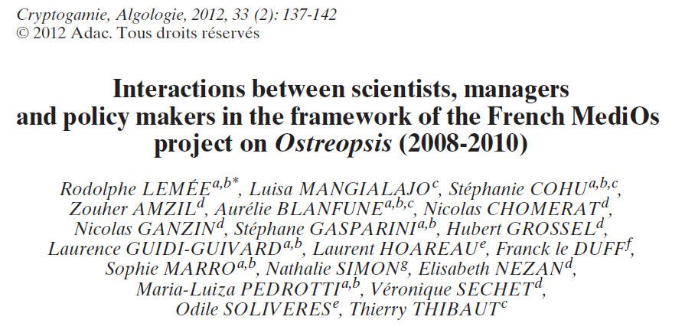
4. Monitoring Ostreopsis blooms. Shared protocol and data
Atlas production of ecosystem status, pressures and environmental risk index. Pressure: Ostreopsis
Layer source: Monitoring and management of Ostreopsis flourishes in catalonia's coastal bathing waters - Catalan Water Agency (ACA) & ICM-CSIC
Methodology: Collection of macroalgae samples (Ostreopsis reservoirs) from specific locations with intense beach tourism.
Macroalgal samples are shaken to release cells linked to Ostreopsis. The abundances of released cells are estimated by optical microscope (ShareMed WP3 delivered).
https://doi.org/10.1016/j.hal.2015.10.008
> 500 000 cells·gFW⁻¹ Health risk
https://doi.org/10.7872/crya.v33.iss2.2011.137
> 200 000 cells·gFW⁻¹ Warning
20 000 – 200 000 cells·gFW⁻¹ Bloom
< 20 000 cells·gFW⁻¹ No risk
No detected
Notes:
Data has been provided by the program of “Monitoring and management of Ostreopsis blooms in the coastal bathing waters of Catalonia” which carried out in collaboration between the Catalan Water Agency and Elisa Berdalet's group which is a member of the Sharemed partner from CSIC.
- Si fos possible, posar Ostreopsis (només capital letter, italics) en el quadre

Slide 15
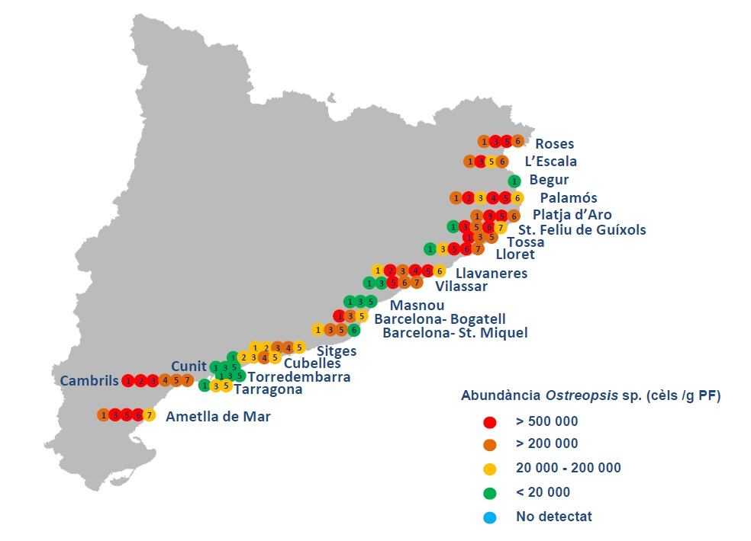
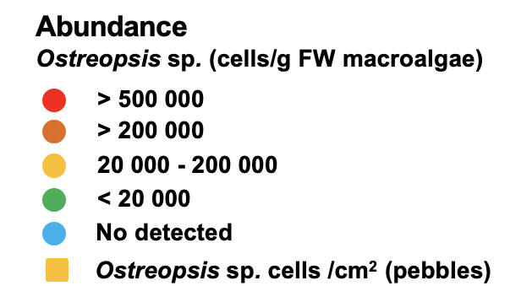
4. Monitoring Ostreopsis blooms. Shared protocol and data
Monitoring in the Catalan coast 2020, 2021, 2022.
ICM and the Catalan Water Agency
2021
Summer 2021
Health risk
Warning
Source: Magda Vila, Laia Viure, Elisa Berdalet and Catalan Water Agency

Slide 16

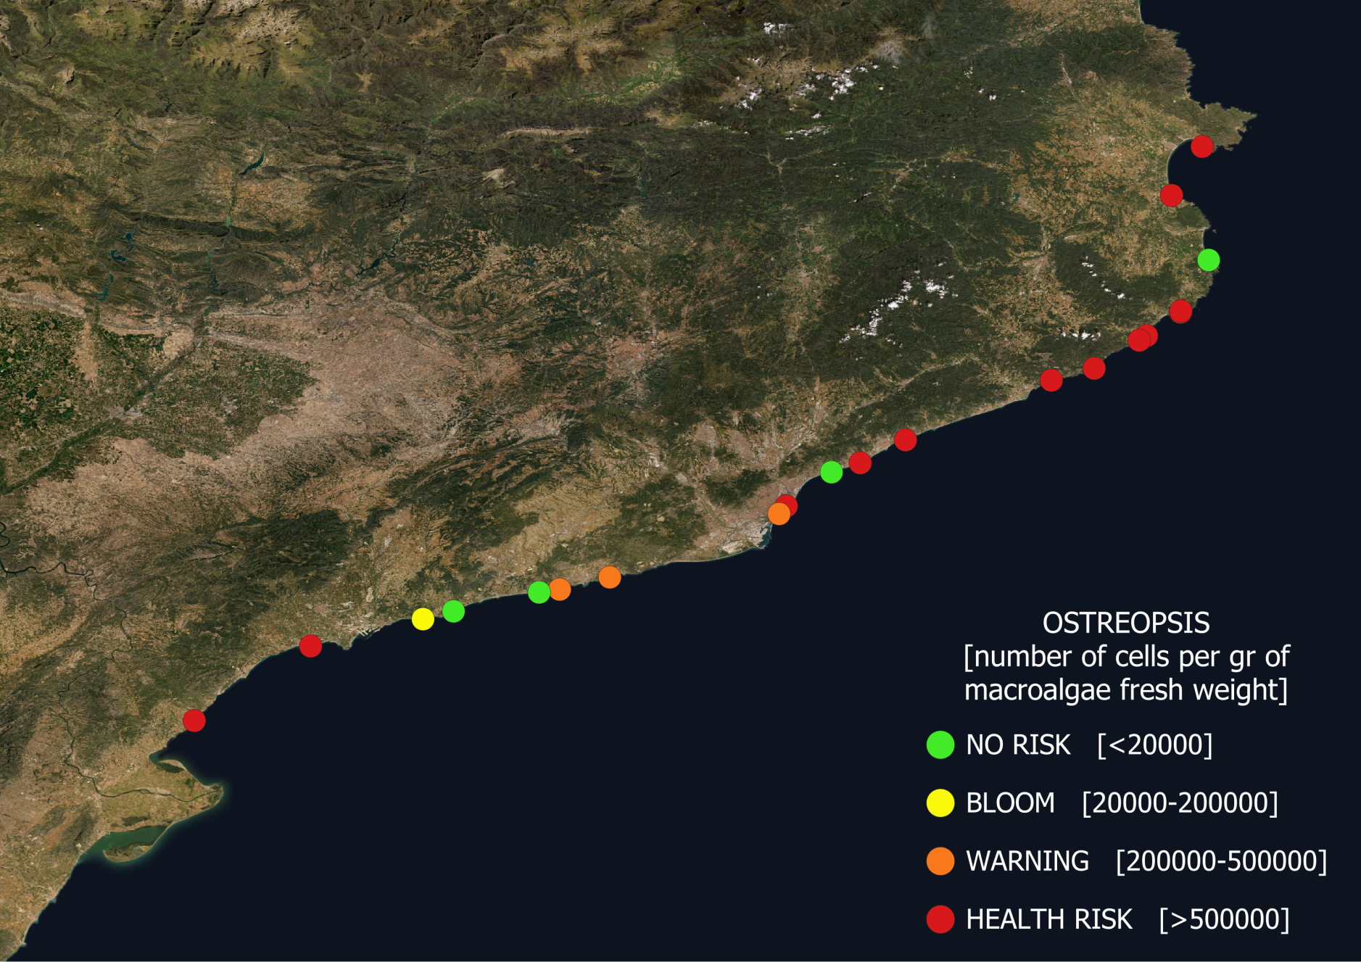
4. Monitoring Ostreopsis blooms. Shared protocol and data
Notes:
Data has been provided by the program of “Monitoring and management of Ostreopsis blooms in the coastal bathing waters of Catalonia” which carried out in collaboration between the Catalan Water Agency and Elisa Berdalet's group which is a member of the Sharemed partner from CSIC.
- Si fos possible, posar Ostreopsis (només capital letter, italics) en el quadre

Slide 17
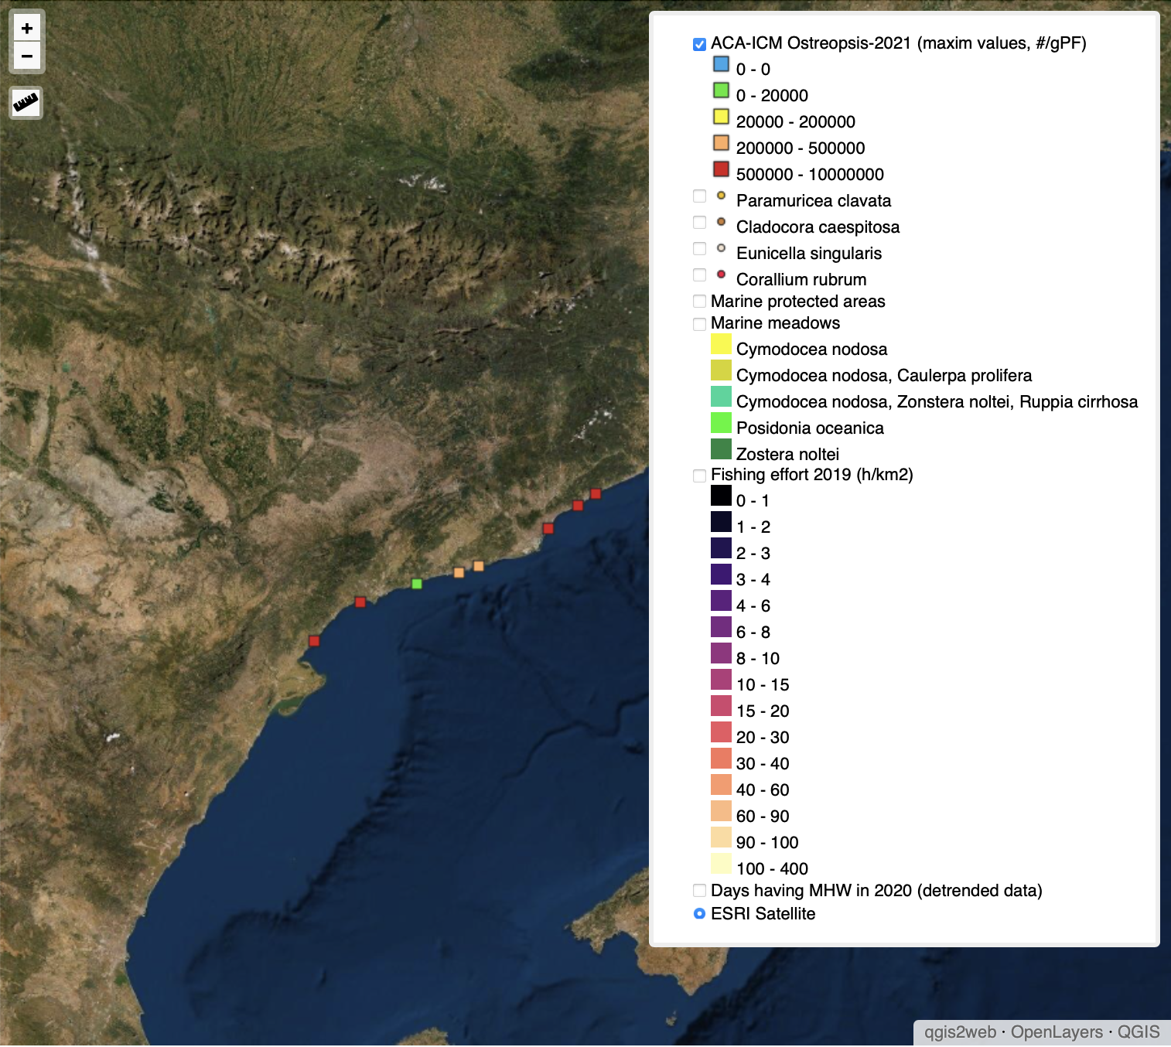
Atlas production of ecosystem status, pressures and environmental risk index. Pressure: Ostreopsis
4. Monitoring Ostreopsis blooms. Shared protocol and data
This is a SHAREMED product for future coordination on Ostreopsis data sharing for designing strategies to prevent impacts on human health and studying climate change trends
Notes:
Data has been provided by the program of “Monitoring and management of Ostreopsis blooms in the coastal bathing waters of Catalonia” which carried out in collaboration between the Catalan Water Agency and Elisa Berdalet's group which is a member of the Sharemed partner from CSIC.

Slide 18


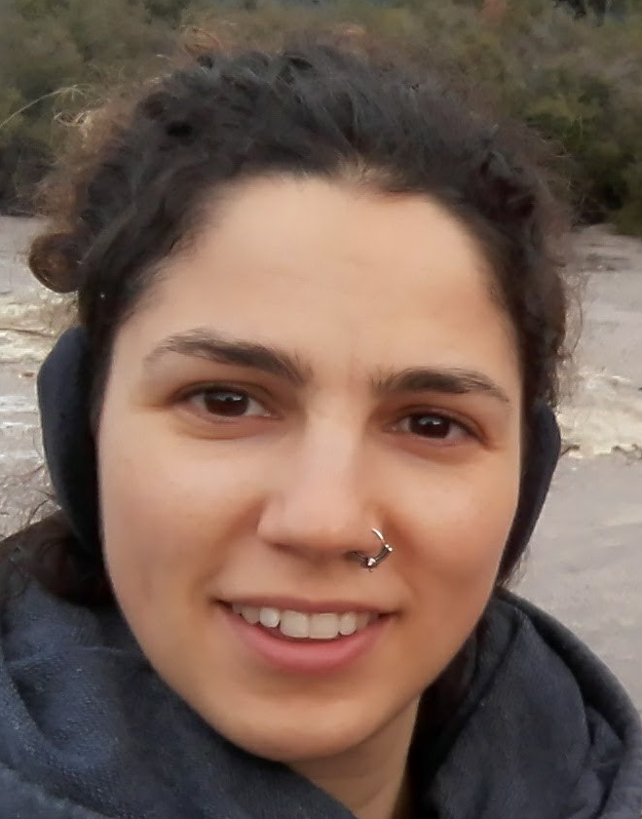





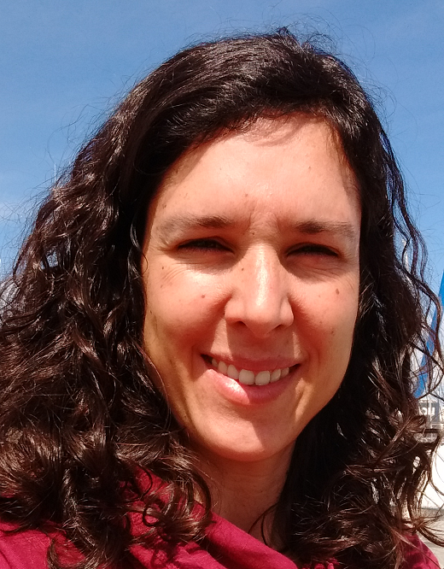
Thank you for your attention!!!
Questions???
ICM ShareMed Team:
E. Berdalet (berdalet@icm.csic.es)
J. Isern-Fontanet, L. Quirós,
S. Galiana, L. Viure, X. Garcia (PI)
Acknowledgements:
Magda Vila (ICM-CSIC)
Catalan Water Agency

